Slide 1


BHARTI VIDHYAPEETH COLLEGE OF ENGINEERING FOR WOMEN, PUNE
DEPARTMENT OF INFORMATION TECHONOLOGY
SEMINAR ON
CRYPTO CURRENCY
PRESENTED BY-
AKANKSHA PATIL (72164357E)
GUIDED BY-
MRS. S. A. HADKE
21st December, 2021

Slide 2
Introduction
Literature Survey
CryptoCurrencies
Architecture
AGENDA
Algorithm
Advantages and Disadvantages
Applications
Conclusion and References

Slide 3





INTRODUCTION
Issue

Slide 4

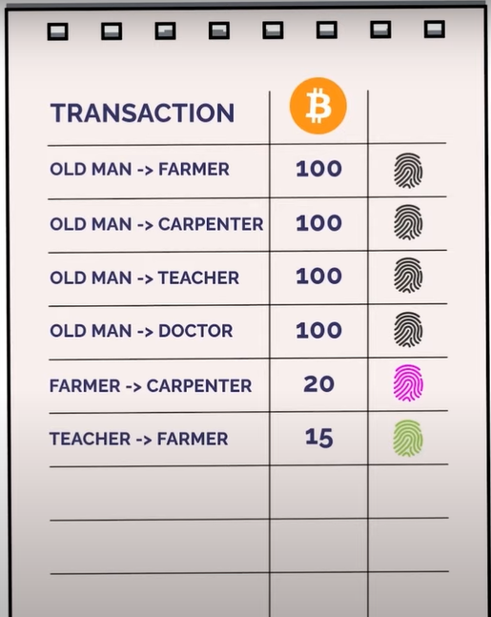
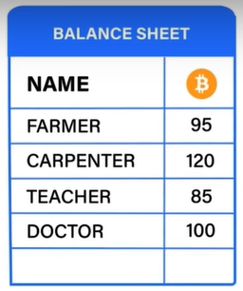
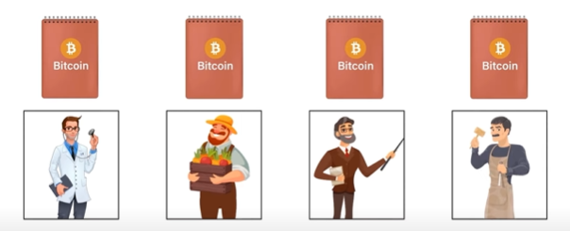
INTRODUCTION (Cont.)
Crypto Currency
Virtual Currency
Decentralize
Secure
Ledger-Trust + Cryptography = Cryptocurrency

Slide 5
Literature Survey
Sr No. | Reference Name | Seed Idea/ Work description | Advantages | Disadvantages / limitations
1 | IEEE 2019 (Trust in Blockchain Crypto Currency) | Key Elements of Crypto Currency and Trust Issues. | Discuss key elements of Crypto Currency in very easy language. | Did not explain how blockchain plays important role for creation of cryptocurrency.
2 | Bitcoin Whitepaper 2009 (Bitcoin: A Peer-to-Peer Electronic Cash System) | Detail description about Bitcoin transaction. | Discuss Proof-of-work algorithm in easy manner . | It didn’t tell about price manipulation of Bitcoin.
3 | IEEE 2020 (Bitcoin and Blockchain: Security and Privacy) | It is about Bitcoin privacy and attack. | Discuss attacks on Bitcoin in detail. | Paper Only discuss about Bitcoin attacks not for other currency.

Slide 6

Trust in Blockchain Cryptocurrency System
Introduction to Crypto Currency
Key Elements of Crypto Currencies
Top Crypto Currency
Trust Issues of Crypto Currency

Slide 7

Bitcoin: A peer-to-peer electronic cash system
This paper is publish by Santoshi Nakamoto
Introduction
Transaction (BlockChain Explained)
Proof of Work
Network
Privacy

Slide 8
Bitcoin and Blockchain: Security and Privacy
Security and Privacy of Bitcoin
Bitcoin wallets in terms of security, types of services, and their trade-offs.

Slide 9




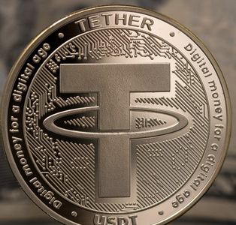
CRYPTOCURRENCIES
Bitcoin
(2009)
Ether
(2015)
Ripple
(2012)
Litecoin
(2011)
Tether
(2014)

Slide 10

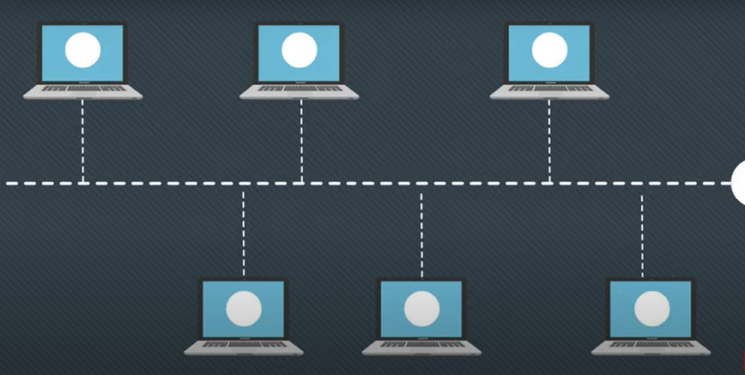

ARCHITECTURE
Transaction msg. pass over network
Transaction initiated
Unconfirmed - Transaction Pool

Slide 11

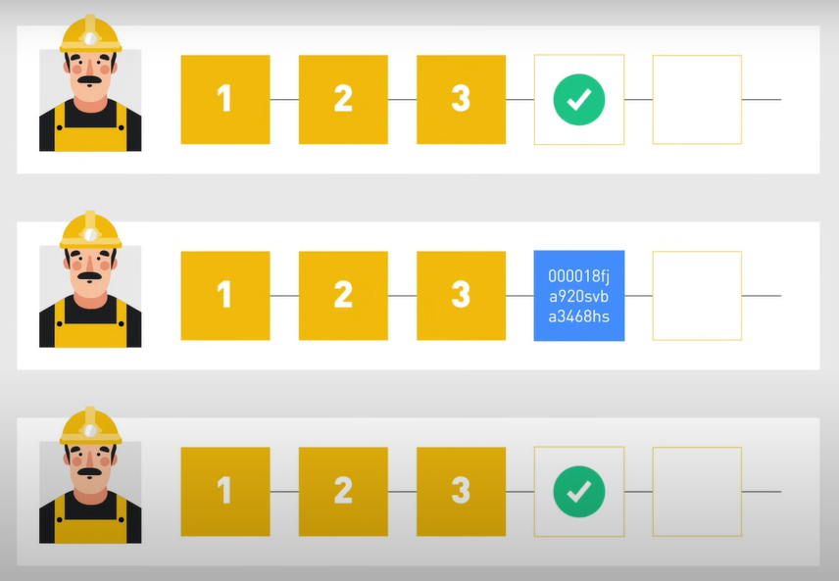
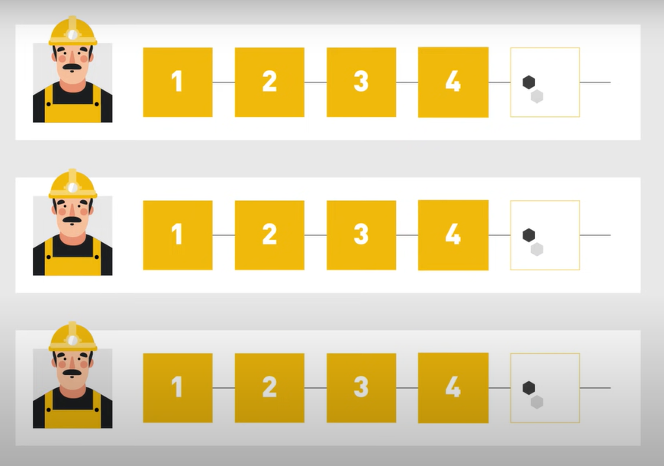

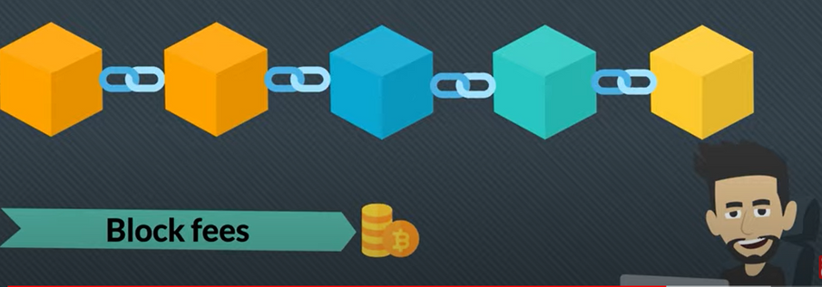
ARCHITECTURE (CONT.)
Miners - Validate Transaction
Validate Block
Add Block in Blockchain
Transaction Completed
Miners Receive Reward

Slide 12
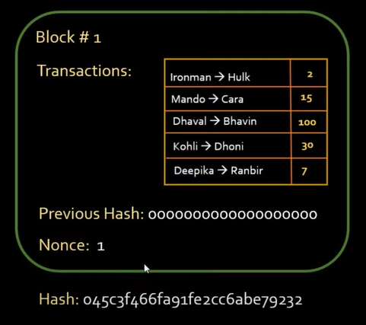
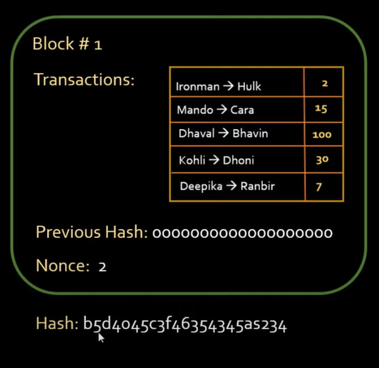
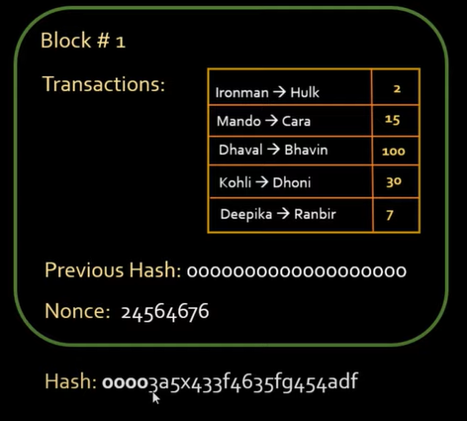
ALGORITHM (PROOF-OF-WORK)
Difficulty Level 4

Slide 13
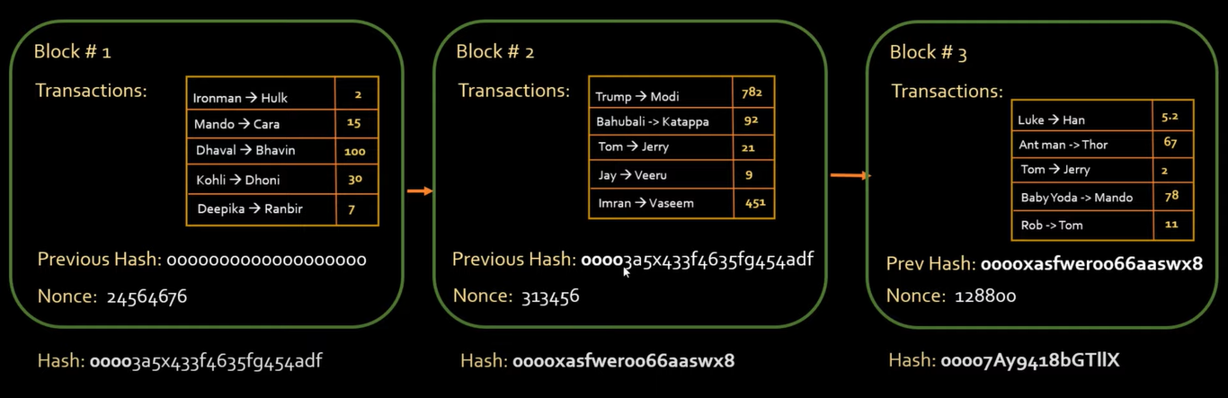
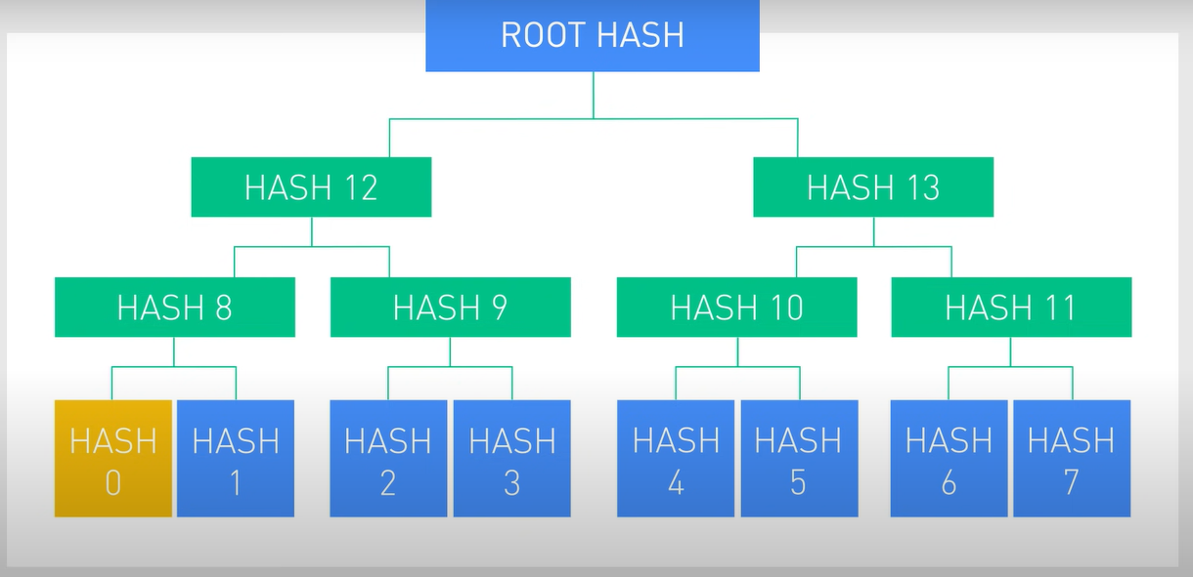
ALGORITHM (PROOF-OF-WORK)
Merkle Tree
Difficulty Level 4

Slide 14
ADVANTAGES & DISADVANTAGES
Secure and Private
Currency exchange can be done easily
Decentralize
A fast way transfer funds
Cost-effective mode of transaction
Can be used for illegal transaction
High Electricity Power Required.

Slide 15

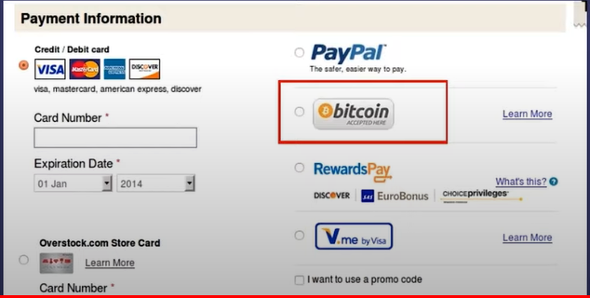


APPLICATIONS
Overstock.com

Slide 16
CONCLUSION
Crypto Currency is exciting concept which has power to alter global market better.
The Technology used in crypto currency are very interesting which provides security of transaction.

Slide 17
REFERENCES
[1] Journal article- Muhammad Habib ur Rehman , Khaled Salah , Ernesto Damiani and Davor Svetinovic "Trust in Blockchain Cryptocurrency System" vol. 67 Page numbers-17 Month year -Nov. 2019
[2] S. Nakamoto, “Bitcoin: A peer-to-peer electronic cash system,” 2008. [Online]. Available: https://bitcoin.org/bitcoin.pdf, Accessed: May 21, 2019
[3] Journal article- Ehab Zaghloul, Tongtong Li, Matt W. Mutka, Jian Ren "Bitcoin and Blockchain: Security and Privacy" Page numbers-25 Date of Publication: 22 June 2020

Slide 18


Thank you

Slide 19
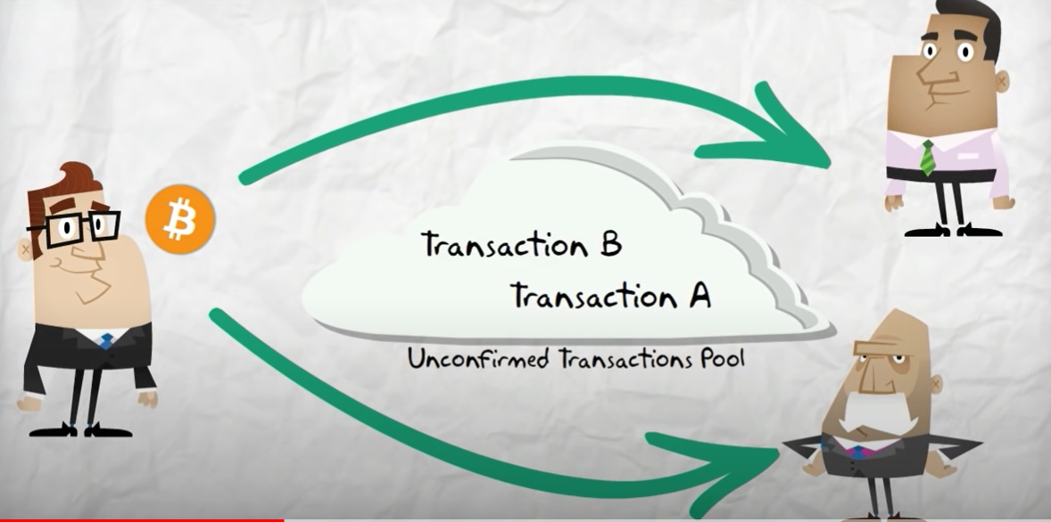
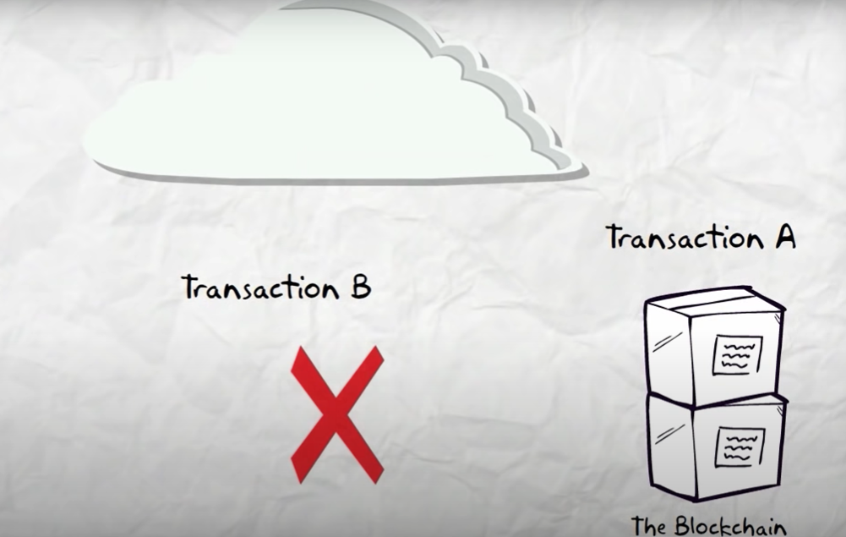
Double Spending

Slide 20
